Slide 1
Project Simulation Process
From Client Onboarding to Project Delivery
05-03-2025

Slide 2
Team Roles for Project Execution
Client Partner | Mukund V
Client | Mihir R
Project Manager | Shashikanth S
Team Lead | Sai Asritha T
Team Member | Sameena P
Delivery Manager | Sanjana K

Slide 3
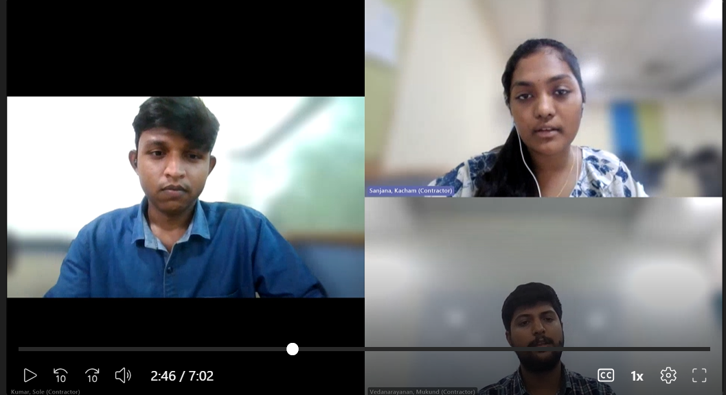
Conference Call Etiquettes
Maintained a formal and consistent team appearance.
Ensured respectful and clear communication with the client and team members.
We were punctual and well-prepared for the meeting.
Used a quiet and professional environment.

Slide 4
Client Initiation:
Client sends requirements via email.
Client Partner (CP) Involvement:
CP replies to the client and schedules a call.
CP communicates the requirements to the Project Manager (PM) and Delivery Manager (DM), requesting the creation of the Software Requirements Specification (SRS).
Project Manager (PM) Actions:
PM discusses with the Team Lead (TL) to assign tasks.
TL informs PM about a team member's unavailability due to illness.
PM ensures the SRS is completed and delivered to the client for approval.

Slide 5
Client Feedback:
Client approves the SRS and provides new requirements or issues.
New Task Assignment:
CP informs PM and DM about the new client requirements.
PM assigns a new team member from the resource pool to address the new tasks.

Slide 6
Thank you

